Slide 1




Spices Raw Materials Price Forecasting

Slide 2
Contents
Business Objective
Business Constraints
Project Architecture
Data Collection
Exploratory Data Analysis
Data Visualization
Notes:
Change

Slide 3
Business Problem
The business problem at hand is the unpredictable fluctuation in the prices of raw spice materials, negatively impacting the cost structure and inventory management.

Slide 4
Project Overview and Scope
Overview: Utilizing advanced analytics and machine learning, the project aims to provide accurate price predictions, enabling strategic decision-making, cost optimization, and enhanced competitiveness in the face of raw material price volatility.
Scope: Developing a predictive model for forecasting raw spice material prices to address cost fluctuations and optimize inventory management for a leading spices manufacturer.

Slide 5
Data Dictionary
1.Timestamp (Date): Date and time of data recording in YYYY-MM-format.
2.Spice_Type: Categorization of raw spices (e.g., ajwan seed) 21 different spices is represented as text.
3.Market_Price: The recorded market price of the respective spice type in rupees currency format.
4.Target_Variable: The variable to be forecasted, representing the future market price of the raw spice material.
5.Data_Source: Indicates the source of the data is extracted from govt of India
6.Data_Quality_Score: A metric reflecting the quality and reliability of the data for each observation.
7.Model_Performance_Metrics: Mean Absolute Percentage Error (MAPE)

Slide 6
Exploratory Data Analysis [EDA]
Statistical Insights
Business Insights
Time-Series Decomposition:
Decompose time-series data into trend, seasonal, and residual components to identify long-term trends and cyclic patterns.
Descriptive Statistics:
Mean Market Price: Average price of raw spice material.
Max Market Price, Min Market Price
Standard Deviation: Measure of price variability.
Min and Max Prices: Range of observed prices.
Quantiles (25th, 50th, 75th): Distribution of prices.
Outlier Detection:
Box Plots: Identify potential outliers in market prices.
Cost Optimization:
Identify periods of lower spice prices for strategic procurement, minimizing production costs.
Market Positioning:
Adjust pricing and marketing strategies based on expected spice price trends for competitive advantage.
Customer Satisfaction:
Ensure stable pricing to enhance customer satisfaction and loyalty amidst market uncertainties.
Supplier Negotiations:
Utilize insights into factors influencing spice prices for more informed negotiations with suppliers.
Risk Mitigation:
Anticipate and mitigate risks associated with geopolitical events or weather patterns impacting spice prices.
Notes:
EDA is used for seeing what the data can tell us before the modeling task.
Change

Slide 7
Data Preprocessing
1. Outlier Detection and Treatment: Identify outliers in the raw material prices or relevant features and decide whether to remove, transform, or handle them appropriately.
2. Handling Missing Values: Identify and address any missing values in the dataset using imputation techniques or removing incomplete records.
3. Data Formatting: Esure consistency in data formats (e.g., date formats) across the dataset for seamless processing.
4. Handling Time Series Data: Set the timestamp as the index for time series analysis.
Consider resampling or aggregating data if needed to align with the desired forecasting frequency.
5. Removing Unnecessary Columns: Eliminate irrelevant or redundant columns that do not contribute significantly to the forecasting task.
Notes:
Keep observations

Slide 8
Model Building
ARIMA (AutoRegressive Integrated Moving Average):
Utilize historical raw material price data to identify autoregressive (AR) and moving average (MA) components, incorporating differencing for stationarity.
Fine-tune hyperparameters, such as order (p, d, q), through grid search or optimization techniques.
Validate the model on a separate dataset and assess its performance using metrics like Mean Absolute Percentage Error (MAPE) or Root Mean Squared Error (RMSE).
SARIMA (Seasonal AutoRegressive Integrated Moving Average):
Extend ARIMA by considering seasonality in the data, incorporating seasonal differencing and additional seasonal AR and MA terms.
Identify and optimize seasonal hyperparameters along with the non-seasonal ones.
Holt-Winters method with multiplicative seasonality:
Use exponential smoothing to update the level, trend, and seasonal components iteratively.
For multiplicative seasonality, apply multiplicative updates to the seasonal component.
Determine the length of the seasonal period (e.g., monthly, quarterly) based on the data frequency.
Simple Exponential Smoothing:
Choose an initial value for the level (the first observation can be used).
Select a smoothing parameter (alpha) between 0 and 1.
Iterate through the time series data and update the leve

Slide 9
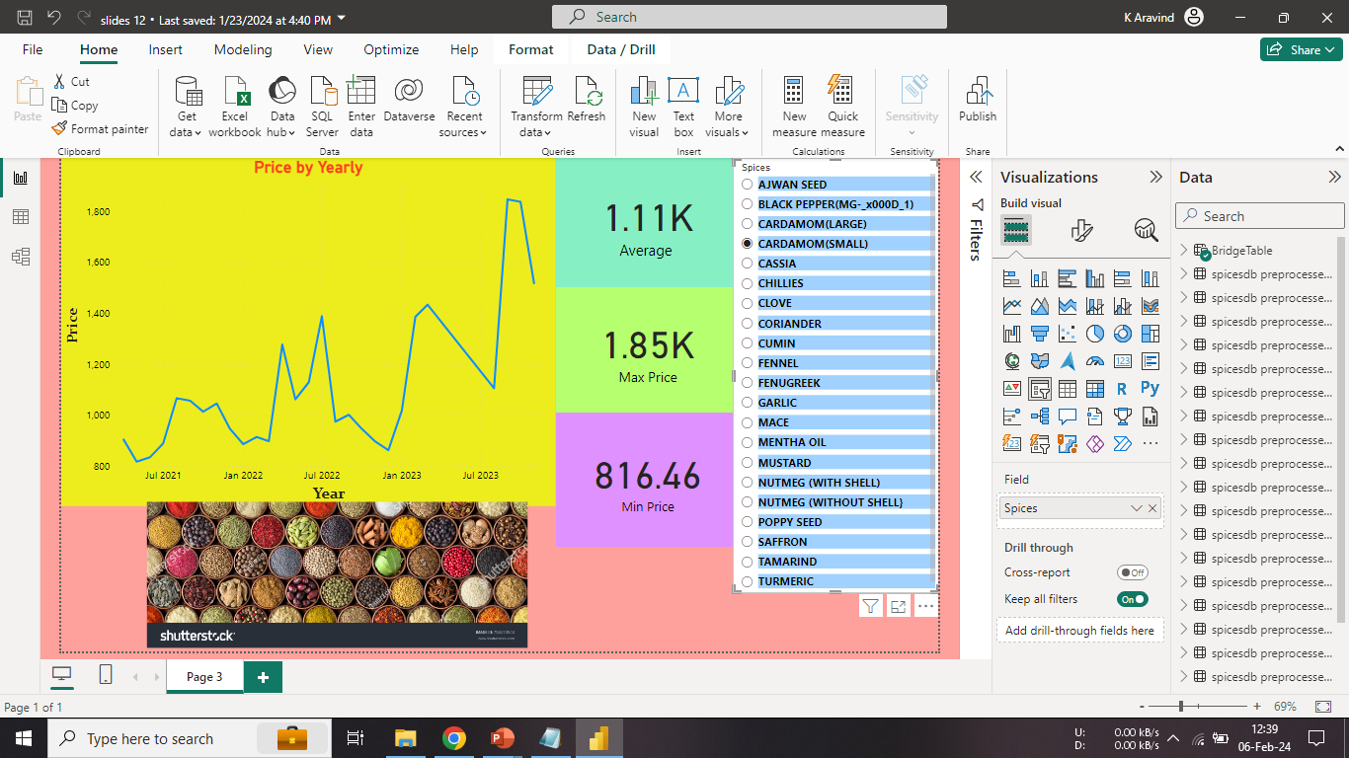
Data Visualization
Notes:
Add graphical

Slide 10


